Slide 1
Edge Detection
Chen-Kang (Angus) Tsai
Email: angus@cereal.cse.nsysu.edu.tw
Date: 2020/12/16

Slide 2
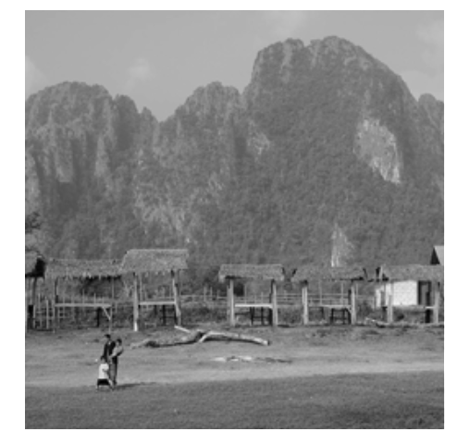
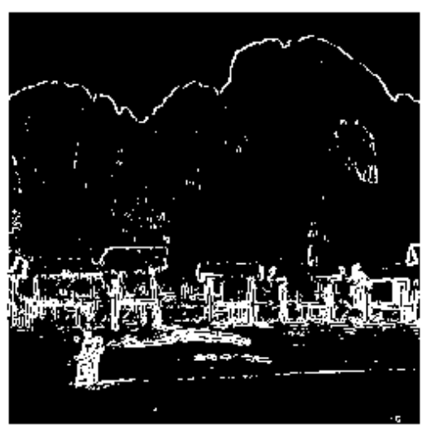
Sobel Algorithm
Sobel algorithm is a kind of edge detection method
The purpose of edge detection is to identify the pixel value with significant change in brightness in digital images.
It greatly reduce amount of data

Slide 3
Sobel Operation
Sobel operation is to multiply input data with kernel
Need to padding
The kernel has been fixed to two form
X-direction
Y-direction
-1 | 0 | 1
-2 | 0 | 2
-1 | 0 | 1
 | -119
255 | 255 | 255 | 235
135 | 234 | 54 | 56
0 | 12 | 43 | 43
0 | 121 | 121 | 12
1 | 2 | 1
0 | 0 | 0
-1 | -2 | -1
 | 953

Slide 4
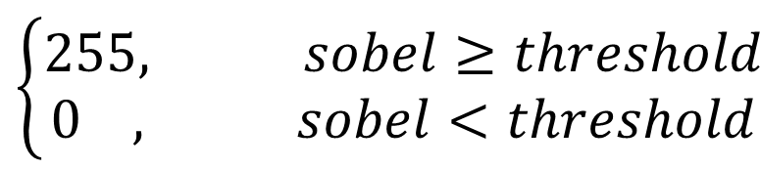
Sobel Operation
After the convolution operation, the next step is to give a threshold to determine where the edge is
Threshold : 128
The lower the threshold, the more edges can be detected
High threshold will miss thin or short line segments
$$\left\{\begin{matrix}255, sobel≥threshold \\ 0 , sobel<threshold\end{matrix}\right.$$

Slide 5
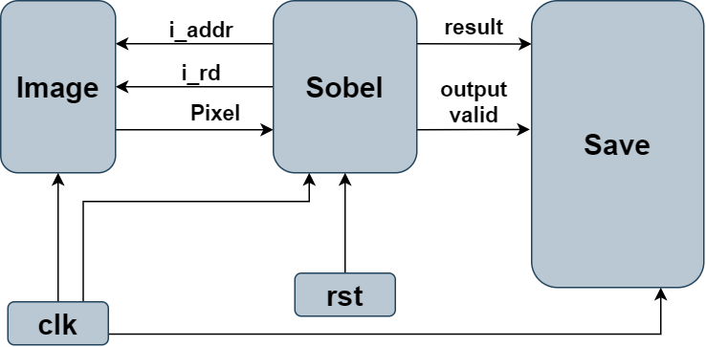
Lab4
Software hardware co-design
System block
clk
reset
Image
Sobel
Save

Slide 6
Lab4
Image is used to read and store the pixel value
There are some signals to control the image block
i_rd
i_addr
Index
data
0
Pixel1
1
Pixel2
2
Pixel3
65533
Pixel65534
65534
Pixel65535
65535
Pixel65536
Rom

Slide 7
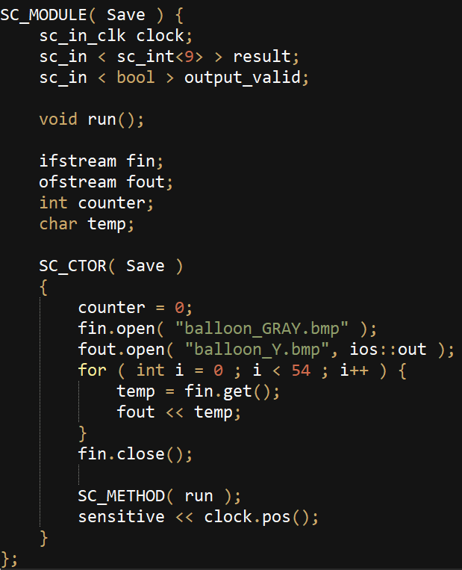
Lab4
Write
When output_valid changes to 1, the result is valid
When all pixels are written, stop simulation.
sc_stop()

Slide 8
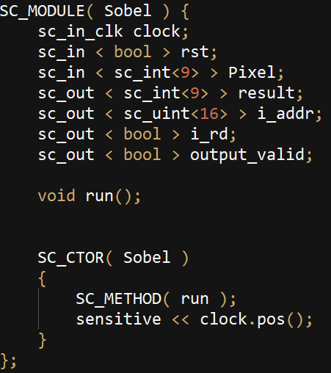
Lab4
Sobel
You need to read the rom data cycle by cycle
Reading data from ROM will delay one cycle
Sobel.h

Slide 9
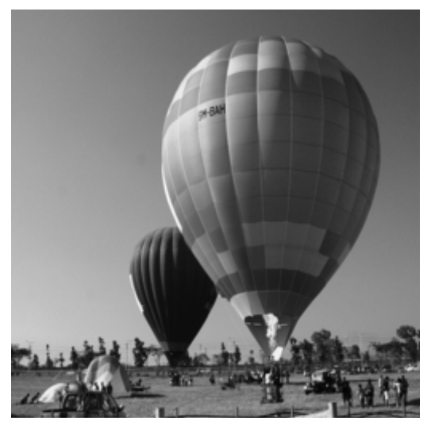
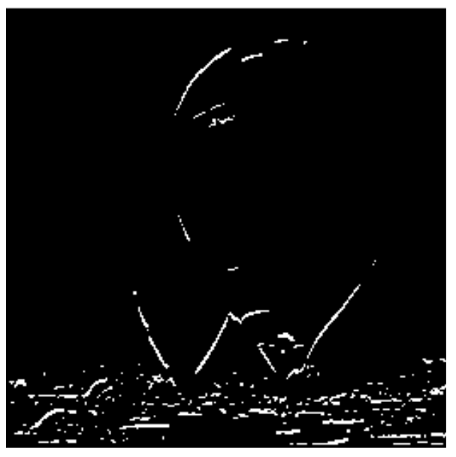
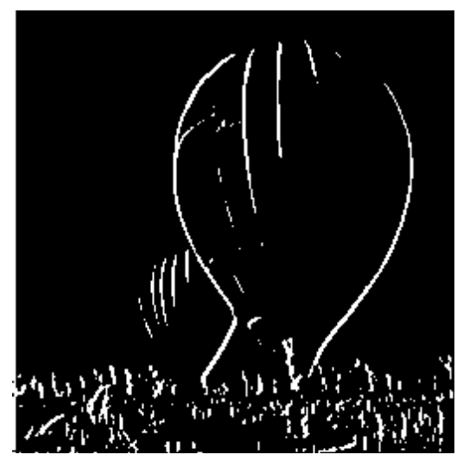
Lab4
Execution result
Original image
Direction X
Direction Y

Slide 10
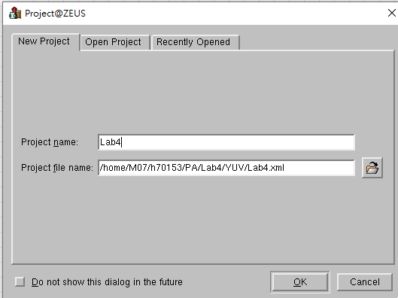
Platform Architect
Create project -> Project name -> Project file name -> OK

Slide 11
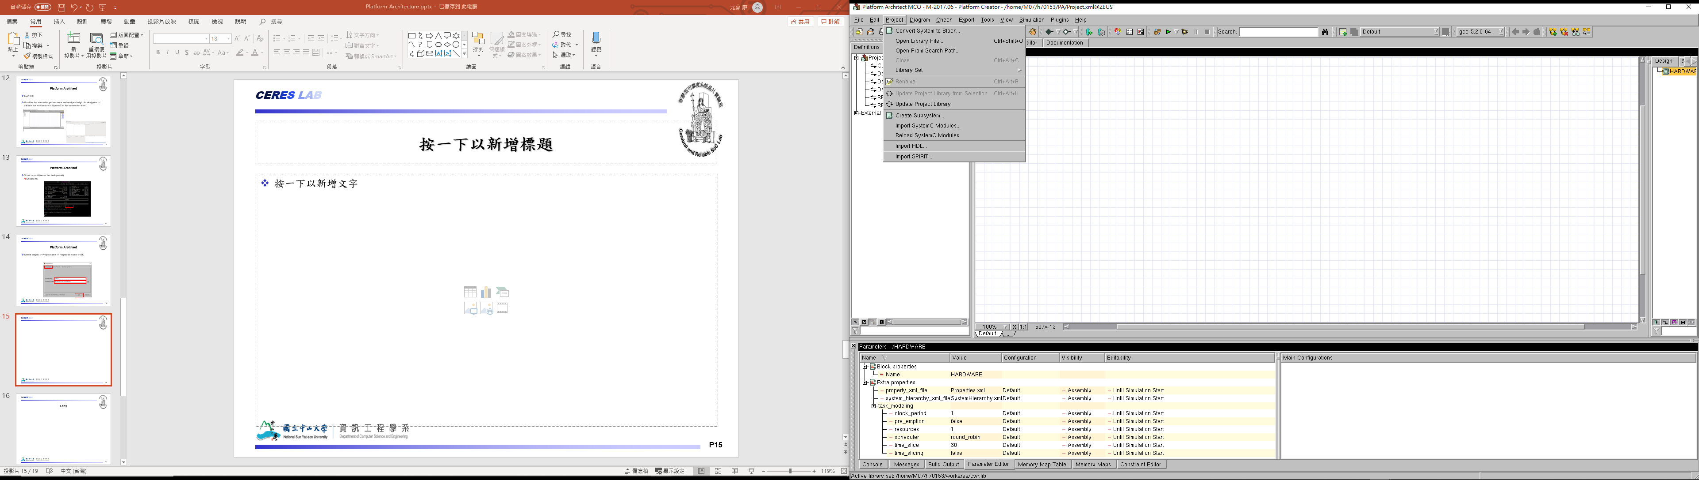
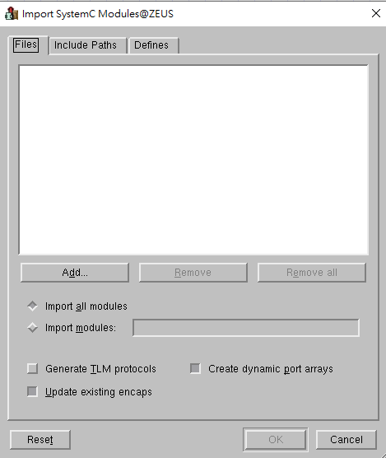
Platform Architect
Import SystemC Modules -> Add -> Choose all the source file

Slide 12
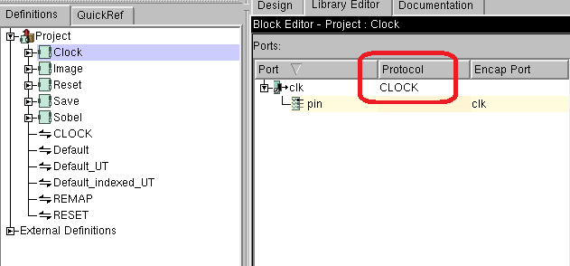
Platform Architect
Set the clk port of Image, Clock, Save and Sobel block to CLOCK protocol

Slide 13
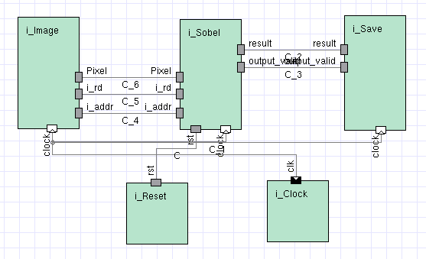
Platform Architect
Create the block diagram

Slide 14
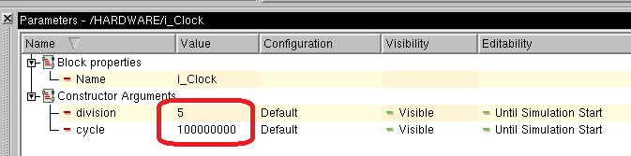
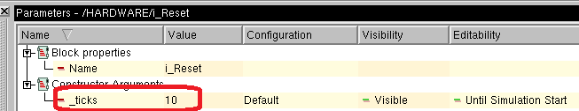
Platform Architect
Click clock block -> Set clock period
division -> 5
cycle -> 100000000
Click Reset block -> Set reset period
_ticks -> 10

Slide 15
Lab4
Execution result
Original image
Direction X
Direction Y

Slide 16
Requirement
Due in one week (12/23)
Complete Sobel operation.
Use Platform Architecture to simulate output result.
Source code ( all of your file, include PA project file, source code…. ).

